Slide 1
Plate Tectonic Theory
According to this theory Earth’s lithosphere is broken into distinct which is floating on aesthenosphere.
In 1967 Meckenzie & Parker suggested this theory.
Morgan Later outlined it in 1968. The force for plate movement Is convection currents in the asthenosphere.
Rate of plate movement is 2.5” /year.
Notes:
Acc

Slide 2
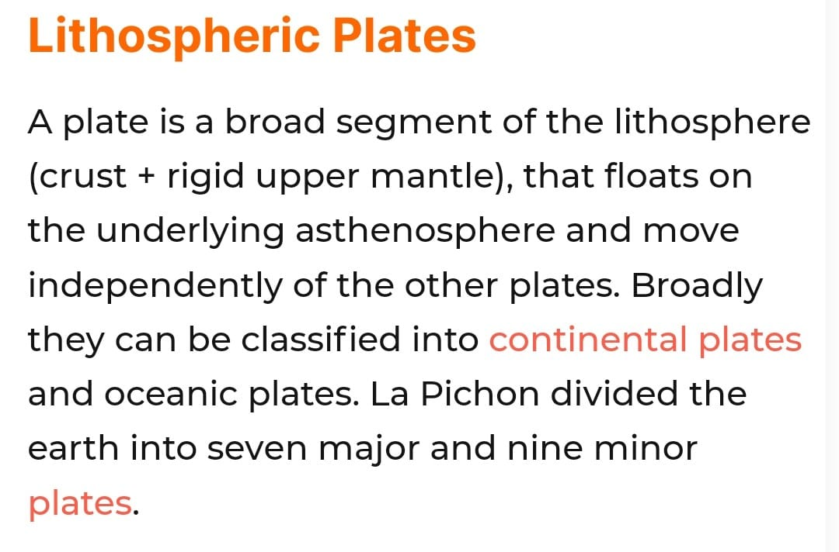

Slide 3
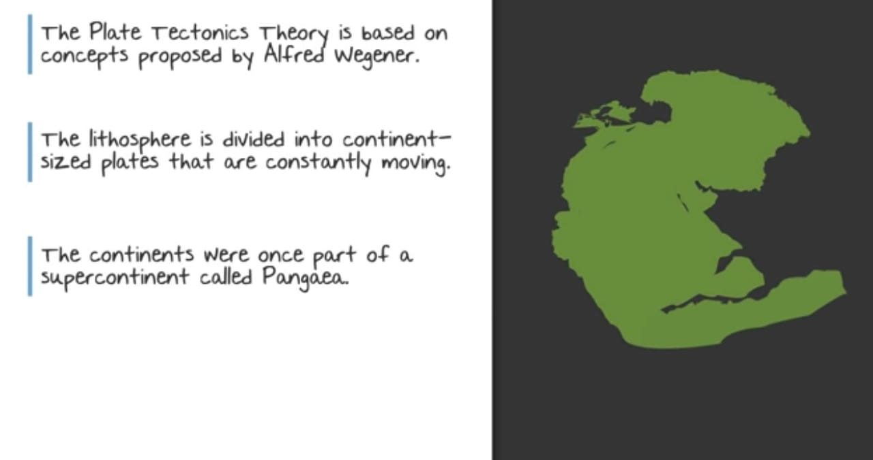

Slide 4
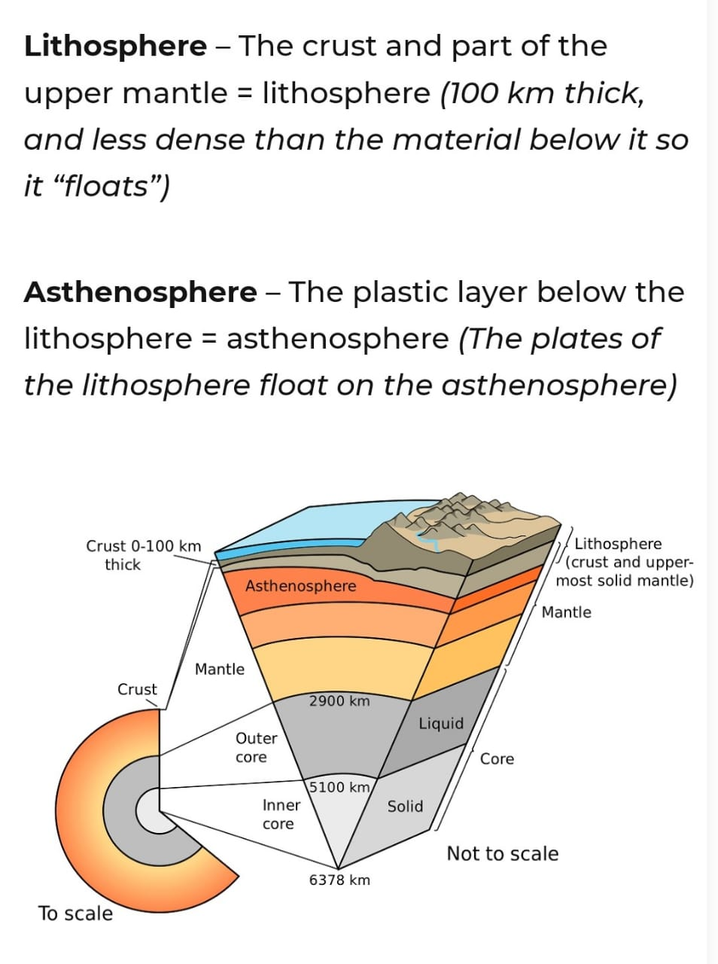

Slide 5
Evidences of plate movement
Paleomagnetism
Sea floor spreading
Age of Rocks- Continental rocks- 3.5 billion years old , oceanic rocks – 75 Million years.

Slide 6
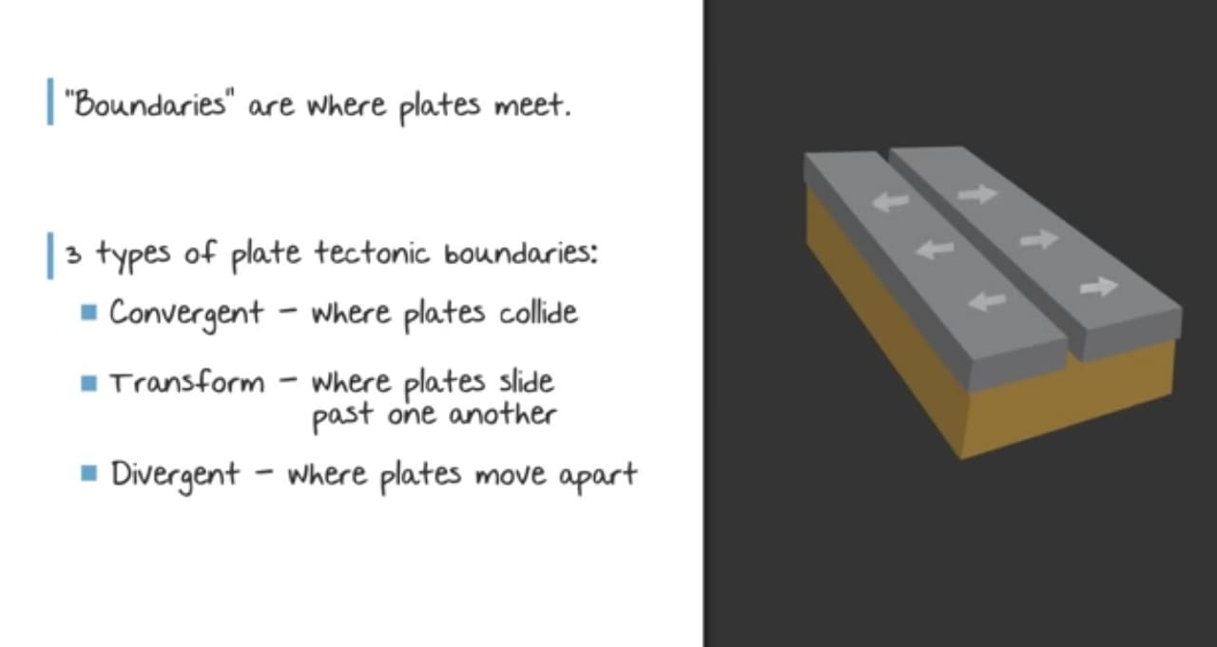

Slide 7
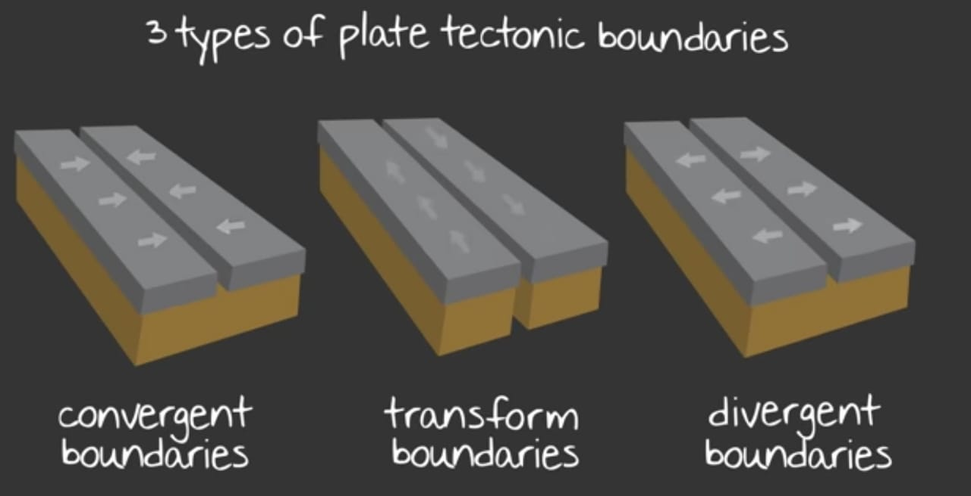

Slide 8
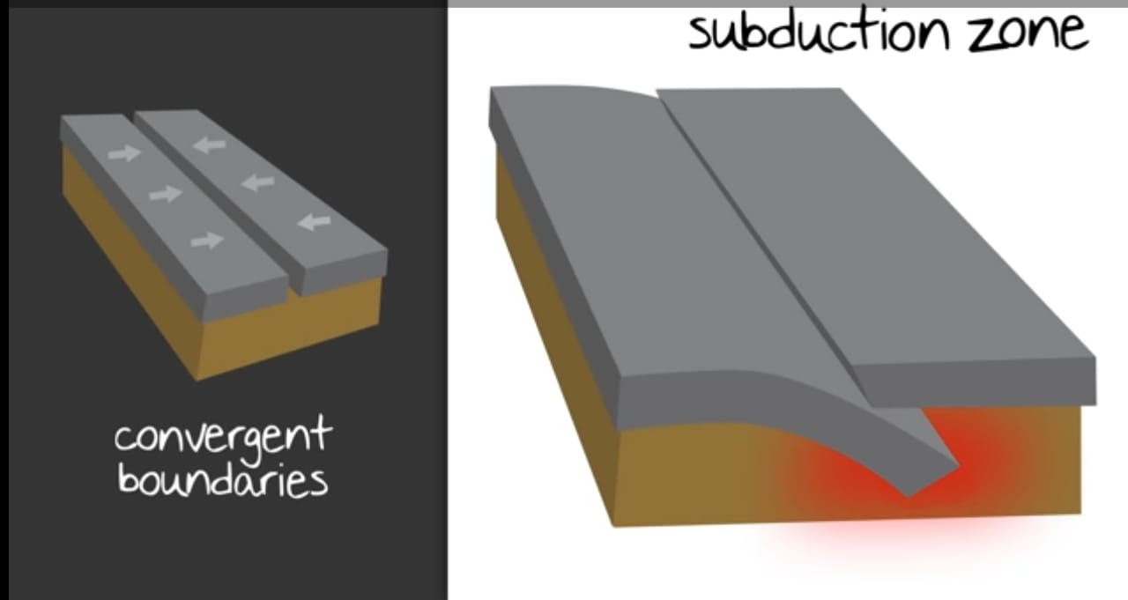

Slide 9
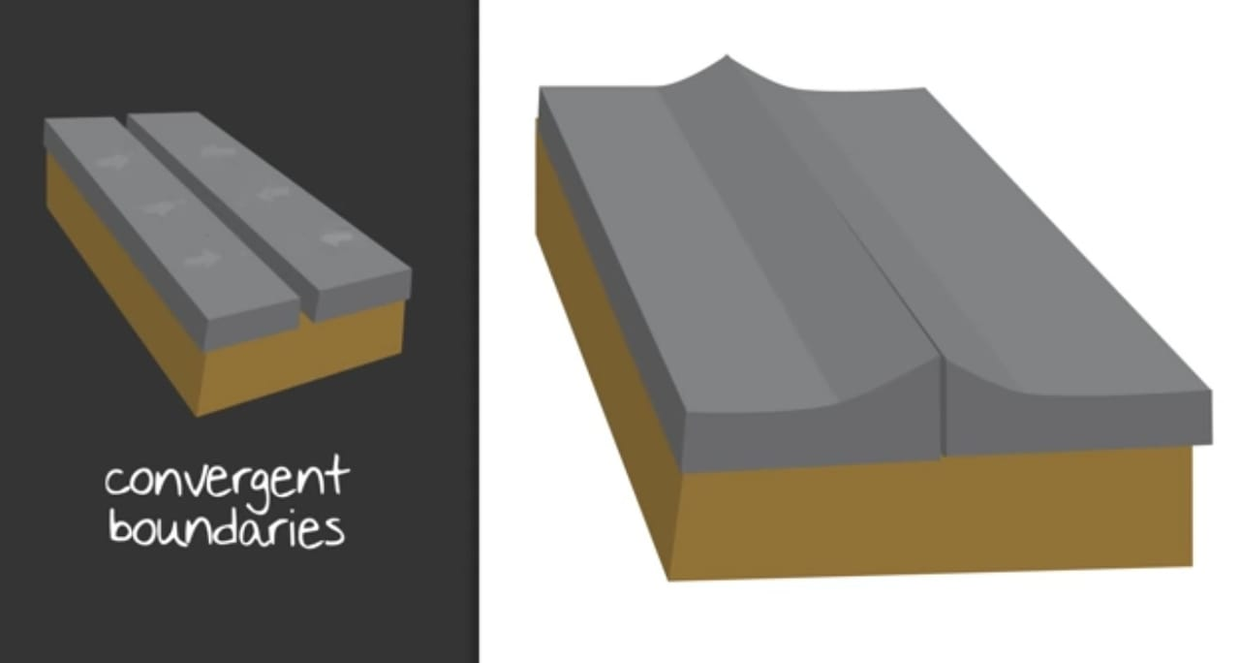

Slide 10
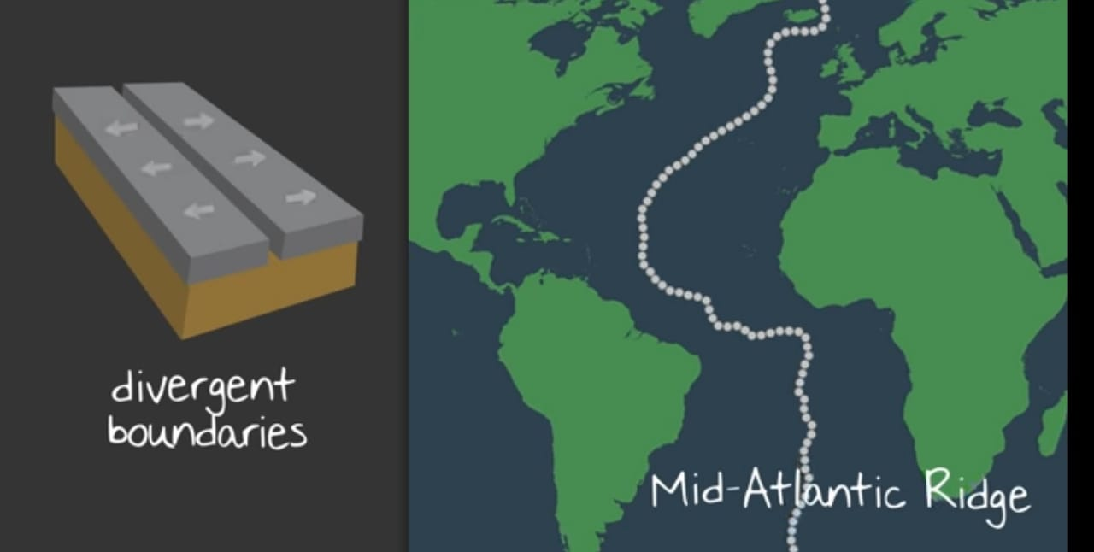

Slide 11
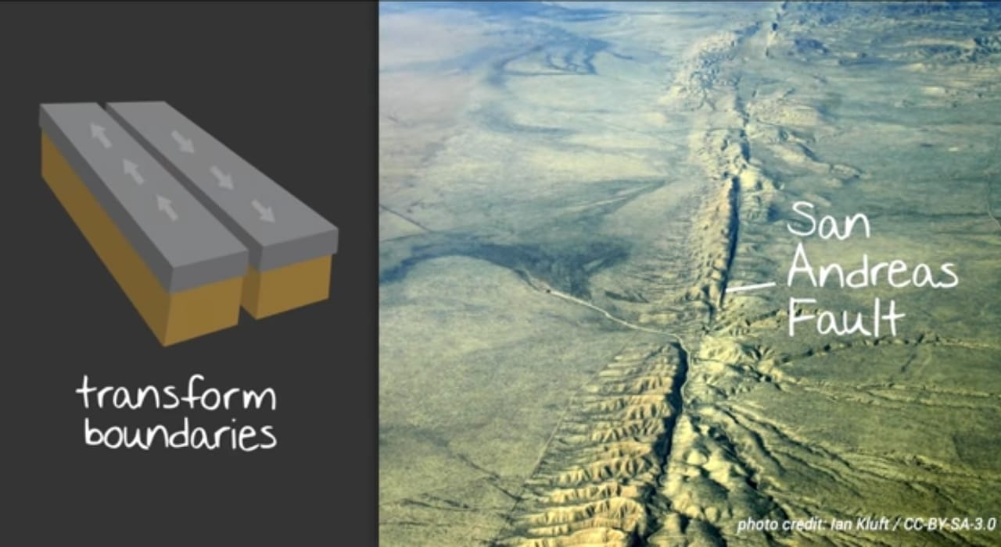

Slide 12
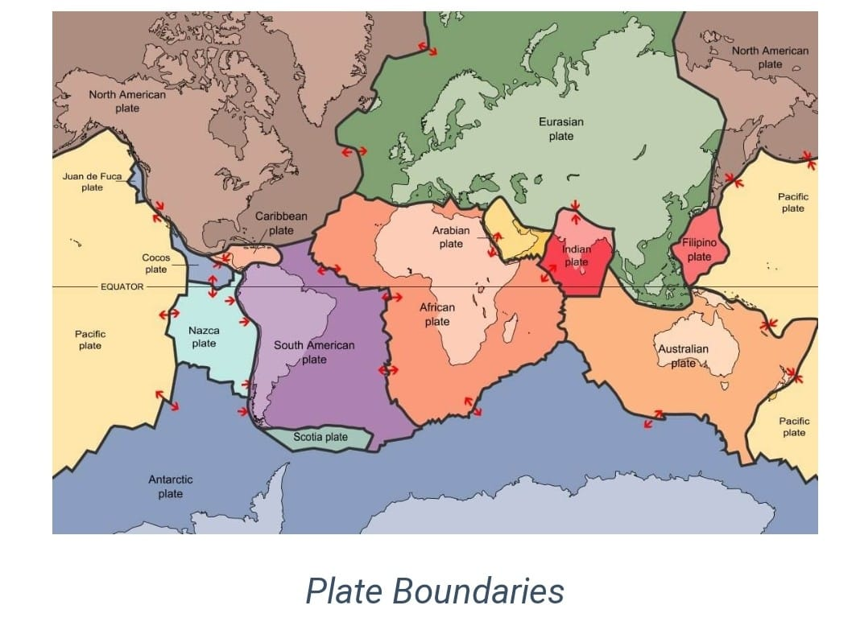

Slide 13
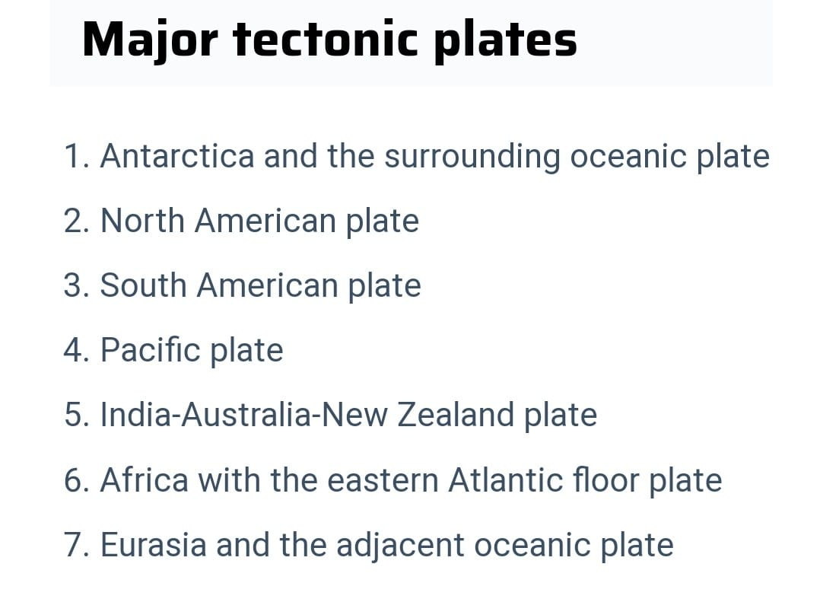

Slide 14
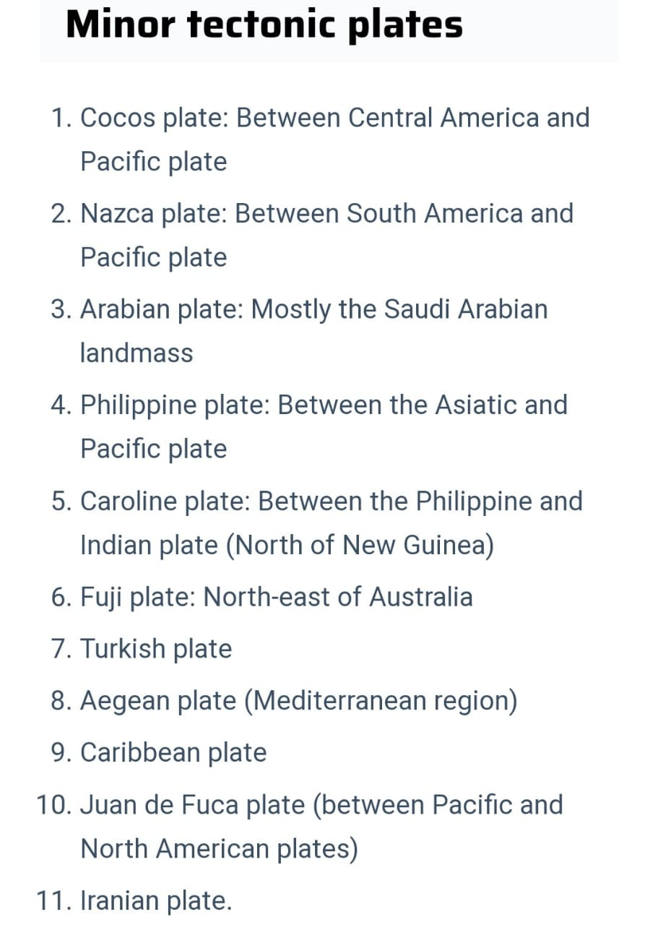

Slide 15
